Slide 1
Veterinary Care
Whitebrook Farm

Slide 2
Why Call the Vet?
It is a lot of work to care for a horse and sometimes we will need help with their care. A veterinarian should give your horse a checkup twice a year, along with giving him vaccinations, checking his teeth and deworming. Those are the routine visits. Sometimes you need to call the Veterinarian at other times. Can anyone tell me when we might have to call the Vet?

Slide 3
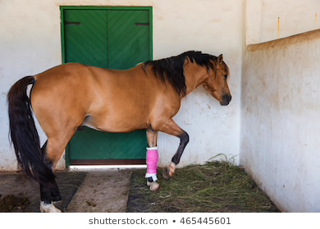
You might need to call the vet for the following things:
• Hurt • Sick • Lame • Too thin or too fat

Slide 4
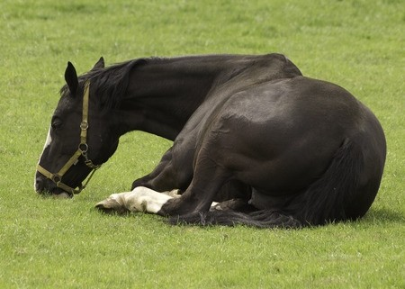
Skin rash
Cough
• Not eating
• Rolling and pawing

Slide 5
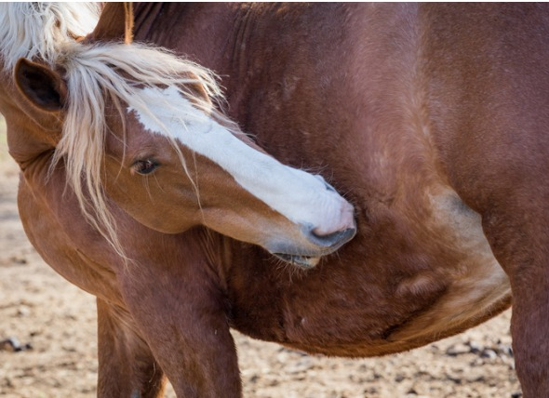
Signs of a Sick Horse
Belly pain as he may stop eating, break out in a sweat, look or nip at his belly, paw, stretch to urinate, lie down and get up, roll. These are serious signs and you should call the vet right away.

Slide 6
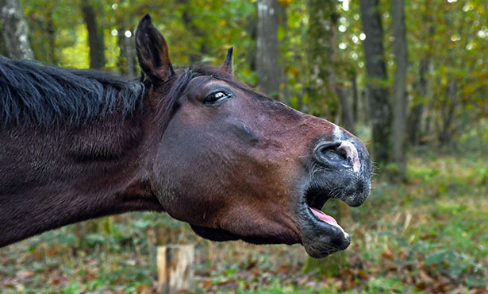
Coughing, especially a wet, mucus one, runny eyes and nose (especially if yellow or green).

Slide 7
Choking, which may sounds like coughing with great distress; green stuff may come out of his nose, he is uncomfortable, walking, pacing. Call the vet immediately.

Slide 8
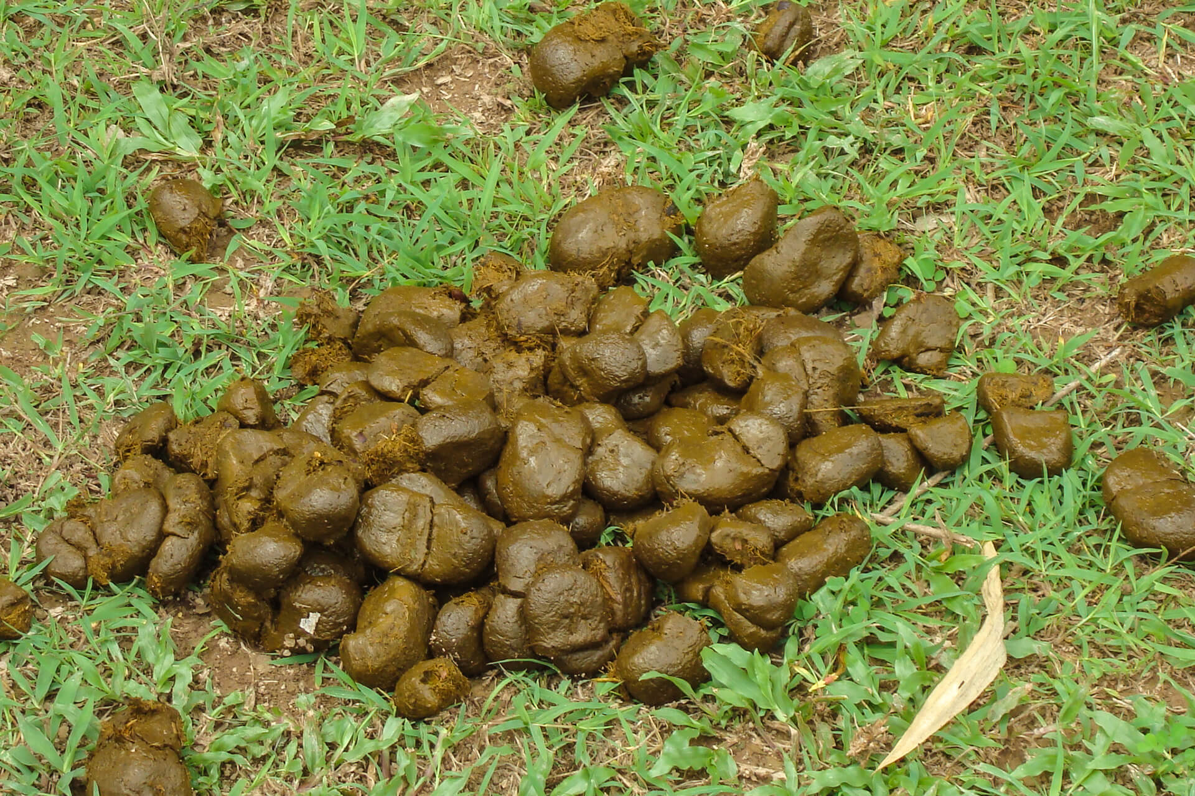
Diarrhea or hard manure balls

Slide 9
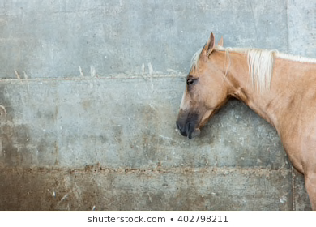
Depressed as he doesn’t want to move, eat or notice anything. He may stand or lie down. He is cranky and irritable.

Slide 10
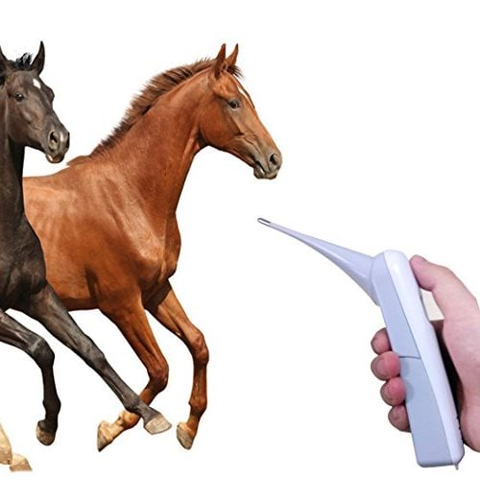
Fever of 1 degree above normal

Slide 11
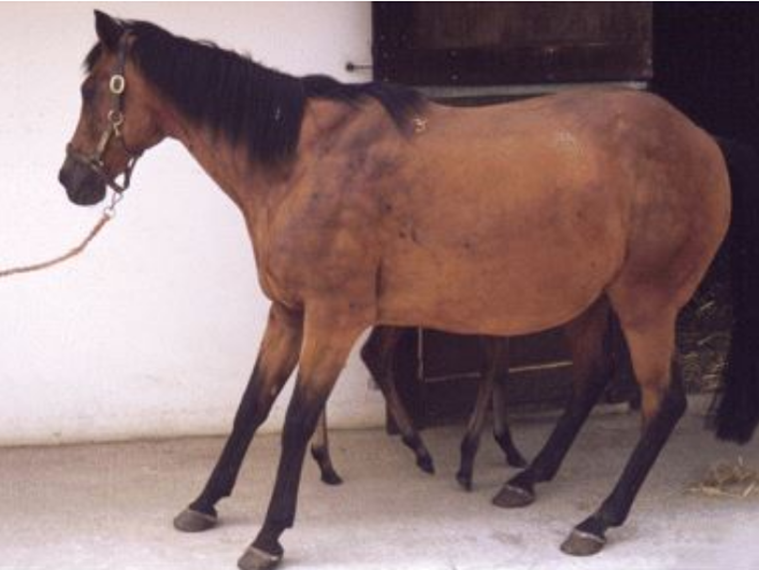
Fever in feet and especially if he doesn’t want to get up

Slide 12
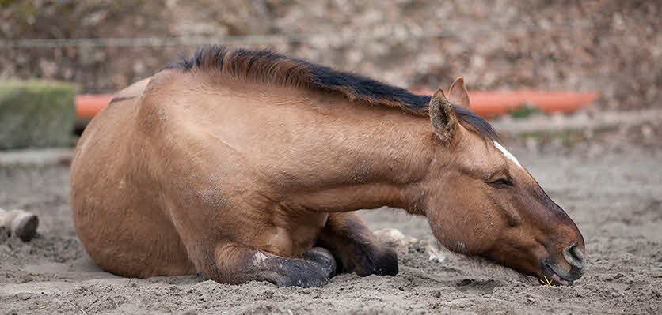
Not wanting to eat or eat normally.

Slide 13
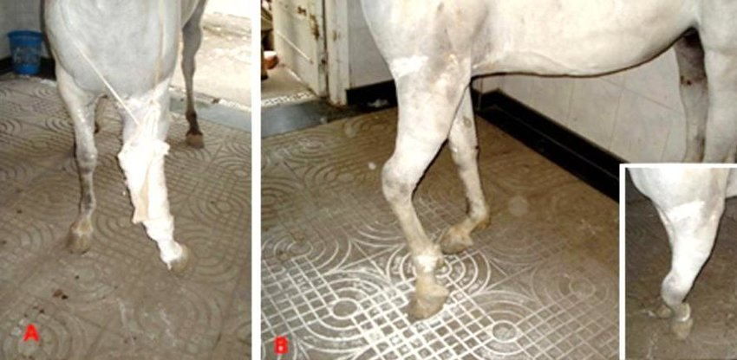
Injuries such as cuts, swelling, heat or tenderness in a leg or elsewhere

Slide 14
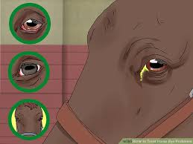
Eye swollen or injured

Slide 15
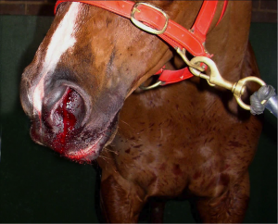
Lame and bleeding

Slide 16
Diseases that can be vaccinated against

Slide 17
How Vaccines Work

Slide 18
Diseases that cannot be vaccinated for
EIA (Equine Infectious Anemia)
You need a coggins test to prove negative
EHV Neurological strain

Slide 19
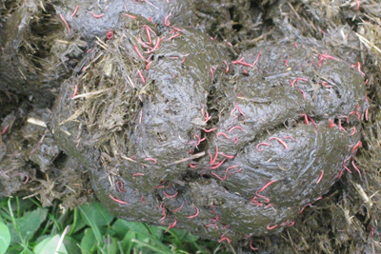
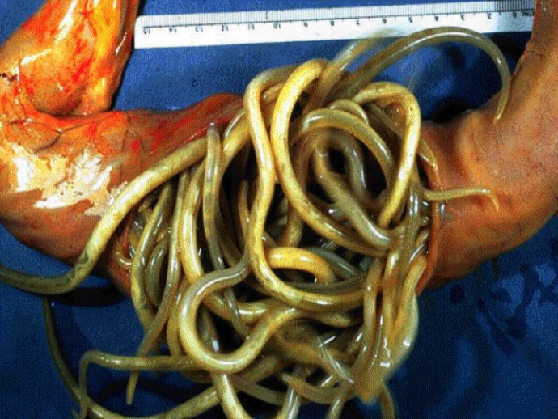
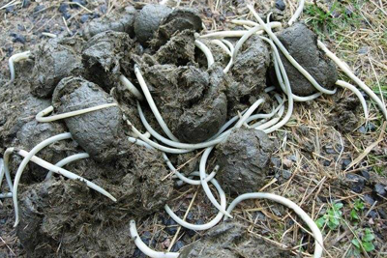
Things that aren’t diseases (vaccinations wont work)
Worms and Parasites
Colic

